Slide 1


PERSONAL FINANCE & INVESTMENTS

Slide 2

Why Financial Wellness Matters
Reduce Stress
Improve Personal life
Enhance Career Satisfaction

Slide 3
Some of the questions that will be answered
How to do Goal-based Investing
How do I save for my kids Eductaion
SIP in Mutual funds vs Direct Equities
Term Insurance Plans vs Traditional Insurance Plans
Should I invest in NPS
How do I save for my centre.
Should I rely on Insurance provided by Employer
Buying a home vs Renting a home
Investments Mistakes/Myths
Portfolio Review and Rebalancing

Slide 4

What are the two major Risks in Life?

Slide 5
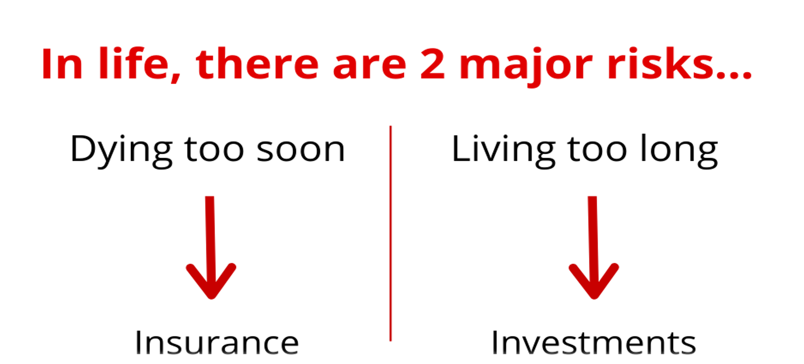



Financial Planning

Slide 6

Rules Of Investing
01 | Return of Capital
 | Payment that an investor receives as a portion of their original investment and that is not considered income or capital gains from the investment
02 | Liquidity
 | The degree to which a security can be quickly purchased or sold in the market at a price reflecting its current value
03 | Return on Capital
 | Measures a company's net income relative to the sum of its debt and equity value.
Notes:
Biggest enemy of investment…?

Slide 7
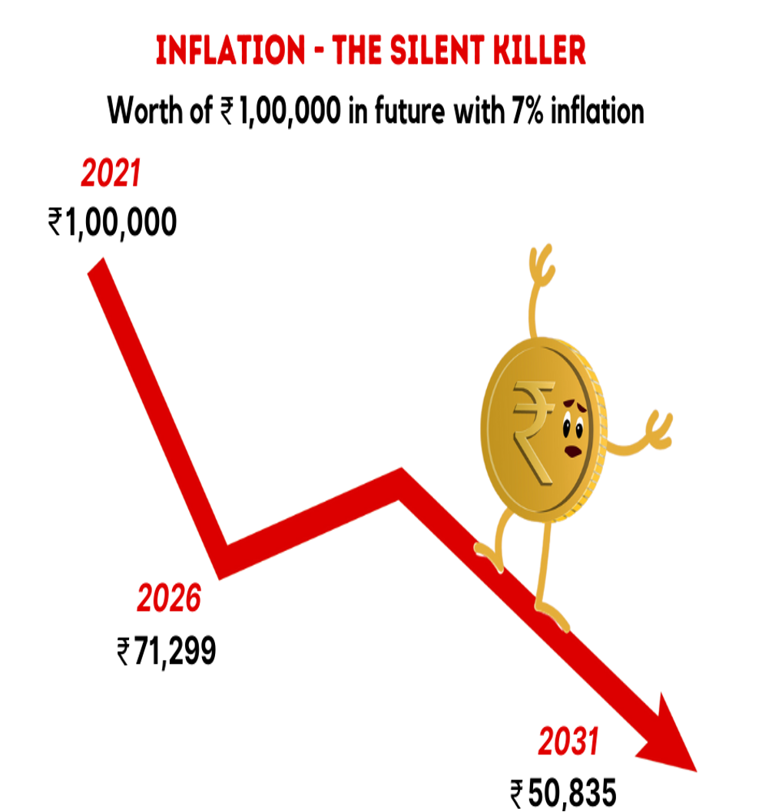


Year 2000: 20 Lacs
Year 2011: 1cr
Notes:
These guys understand better inflation then us

Slide 8



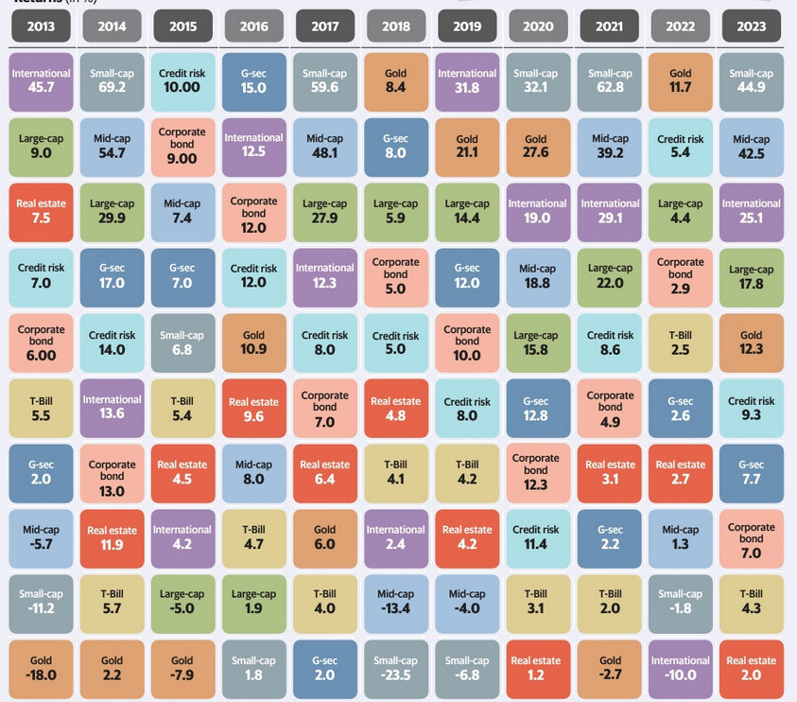
•Absence of any pattern in the returns of asset classes from one year to the next.
Do not predict the next winning asset class
A diversified portfolio may not deliver the highest return in any given year but will perform competitively across market cycles.
Exception of Small Cap in 2020 and 2021, different asset classes on top in each year
Apart from 2016, Gold either ends up being amongst the best asset class in some years and worst in others. No middle way.
Perfect hedge?
Gold slid to bottom of table for 3 years following its run at the top and remained a laggard for 6 years
No market linked product for emergency/short term
Large Cap Funds a no brainer. Apart from 2015 ,large caps have always given positive returns
2020 was covid year. My March, even 40 years of experienced experts predicted doomsday. No asset class gave negative returns. Most were proved wrong. No one can predict correctly.
Rebalance >>>>> Re allocate
Why Diversify?

Slide 9
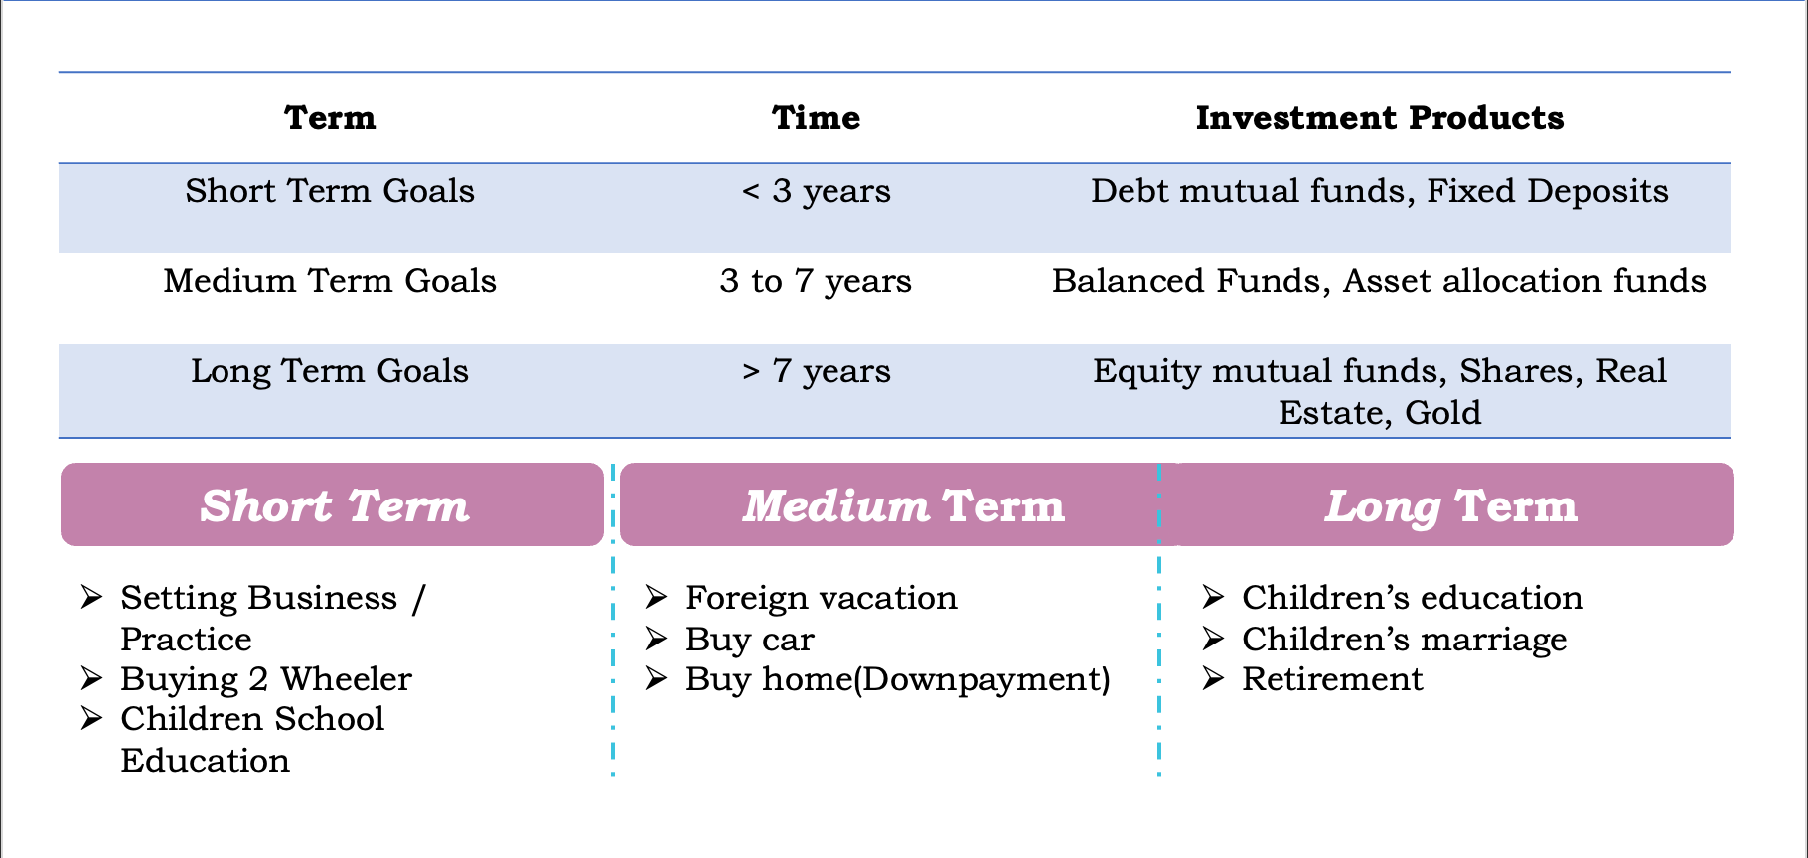
Financial Goals

Slide 10

Most Important Financial Goal?

Slide 11


Investment Option
Market Linked
•Equity Mutual Funds
•Shares
•ULIP
•Real Estate
•Gold/Silver
Fixed Income
•Traditional Plans
•Endowment Policies
•Post Office Savings Deposit
•PPF
•Debt Mutual Funds
•Fixed Deposits

Slide 12
NPS: A great retirement savings option
Regular Pension After Retirement -
On maturity, you receive 60% of the corpus as a lump sum payment, and with the remaining 40%, you have to buy annuities.
Maximum Lock-in
Cannot withdraw till 60.
Professional Management -
By the PFRDA (Pension Fund Regulatory and Development Authority)
Choice of Investments
Active and Auto choice.
Additional tax benefit
Rs 50,000 in a financial year Section 80CCD (1B) over and above the Rs 1.5 lakh deduction under Section 80C

Slide 13
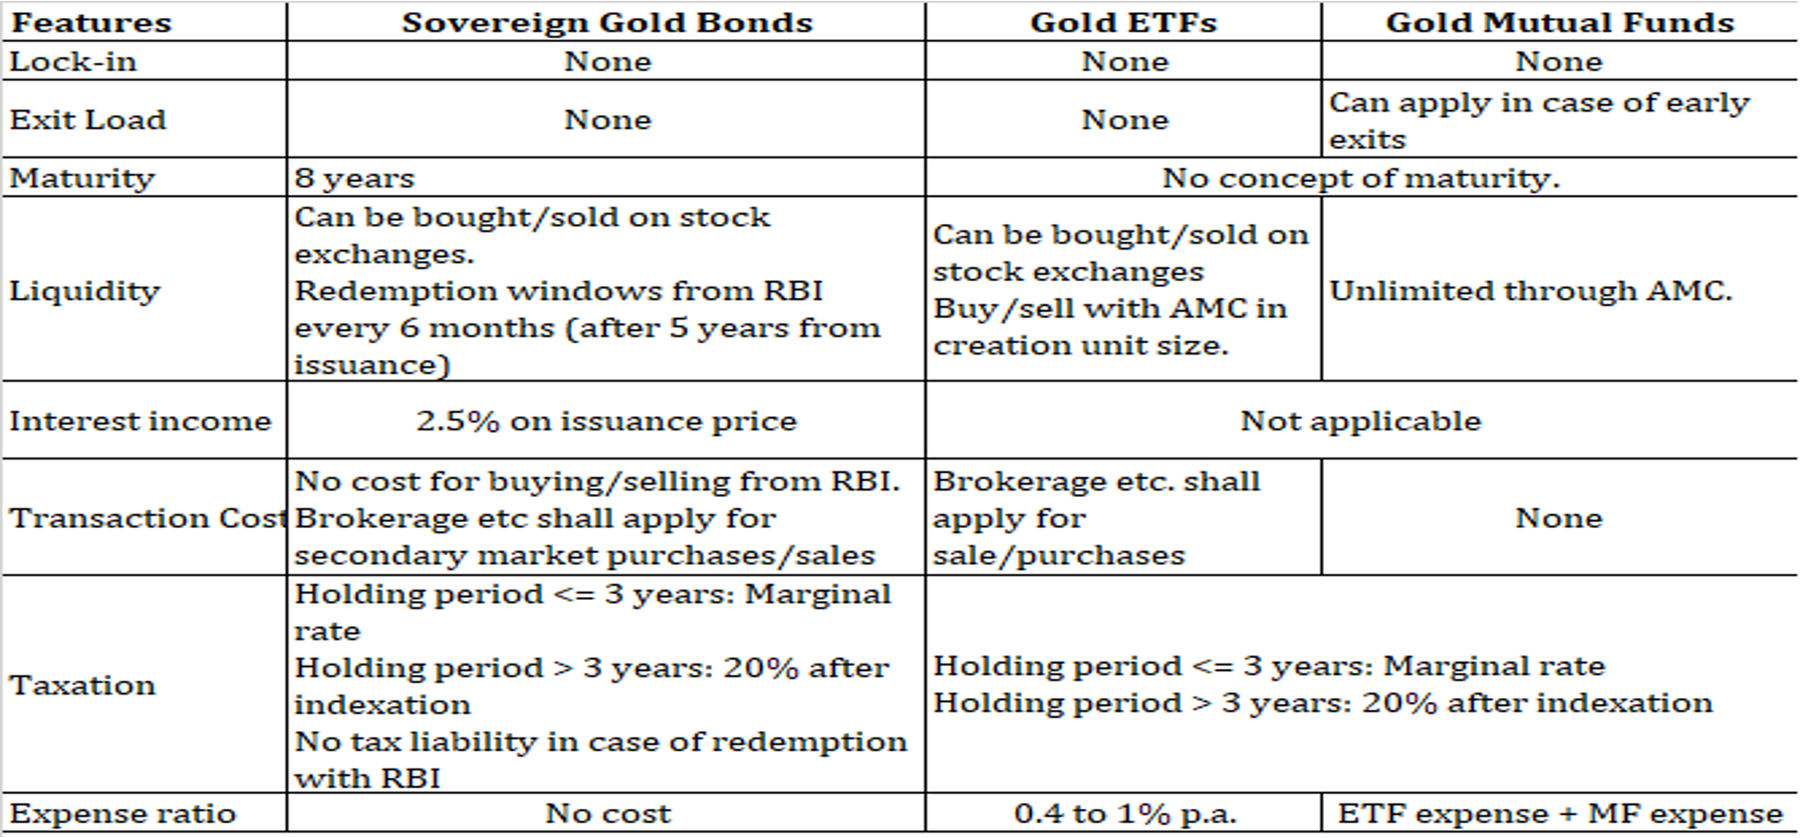
Different Investment Options for Gold

Slide 14
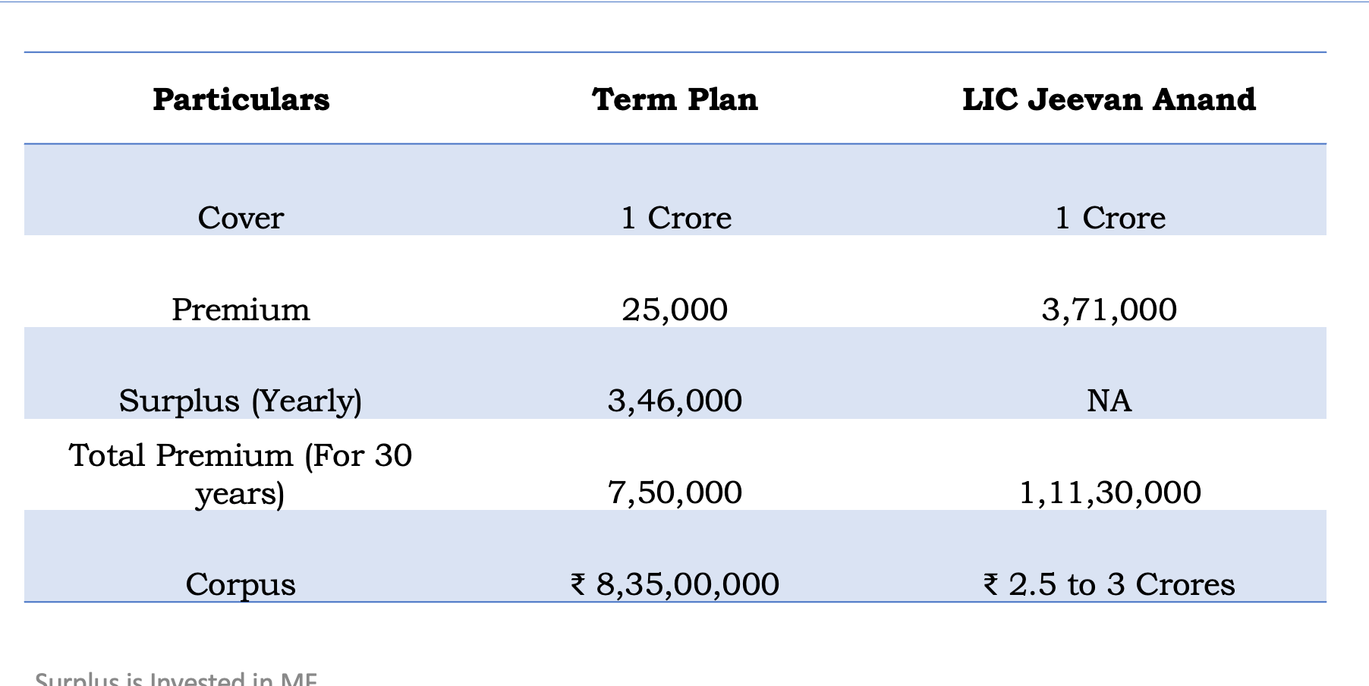
Term Plans V/S Traditional Plan

Slide 15

How should the Risk Planning be done?

Slide 16
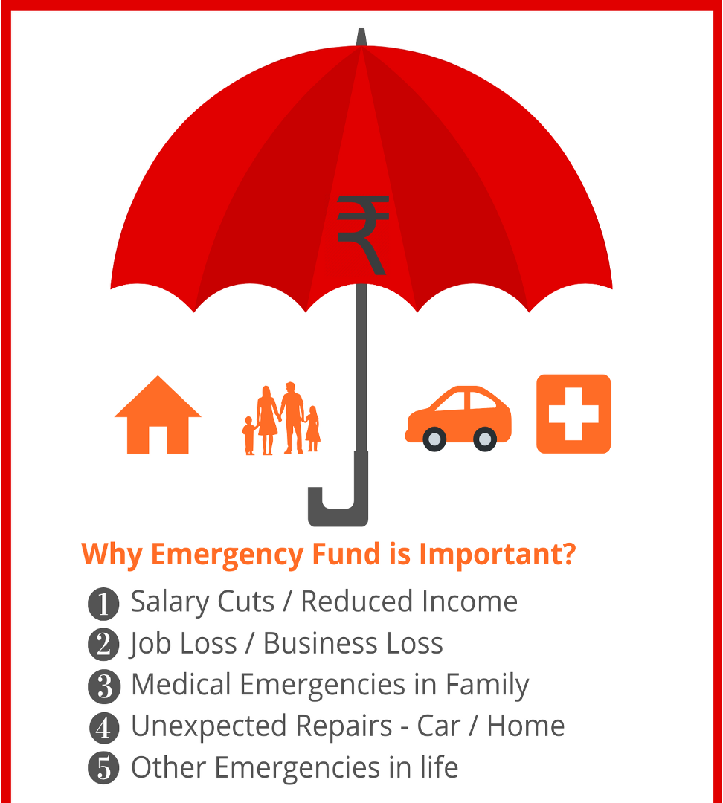

Why Emergency Funds are Important

Slide 17
Investments Mistakes/Myths
•Expecting Too Much returns
•No Investment Goals
•Not Diversifying
•Focusing on the Short Term
•Trading Too Much
•Not reviewing & rebalancing
•Too many insurance policies
•Taking no risk or too little risk
•Investing Is Complicated
•Savings Will Secure Your Future
•My Provident Fund Will Take Care of Post-Retirement Life
•You Must Know How To Time The Market
•Buy More Funds To Diversify And Protect the Downside
•Buying Life Insurance is an Investment

Slide 18
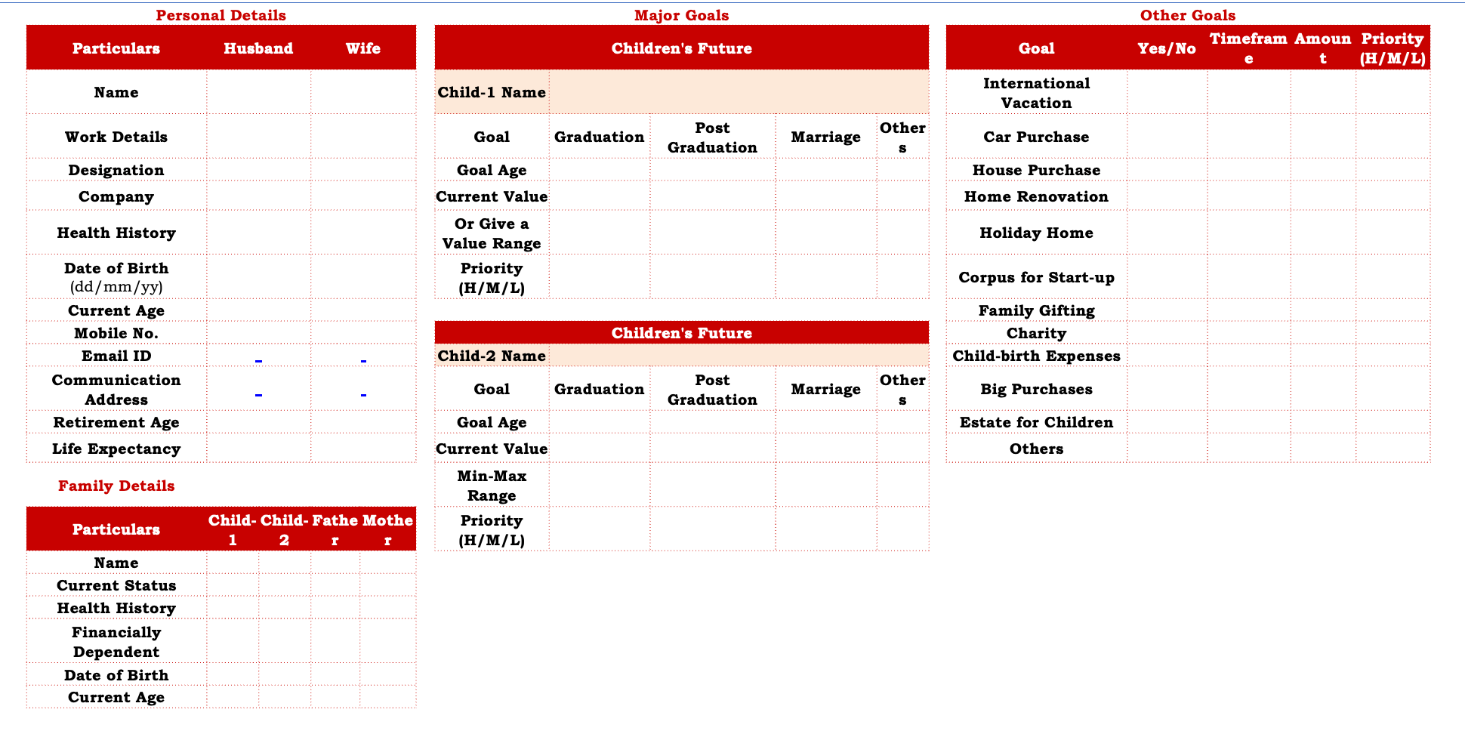
Write down the plan

Slide 19
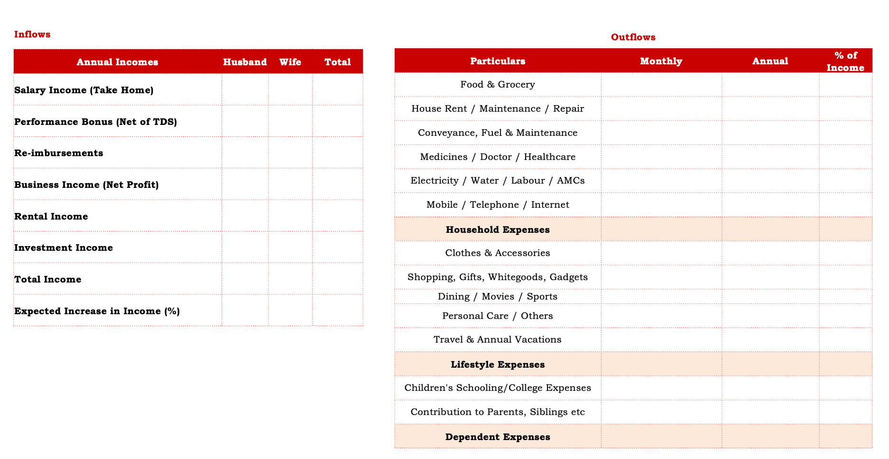
Write down the plan

Slide 20
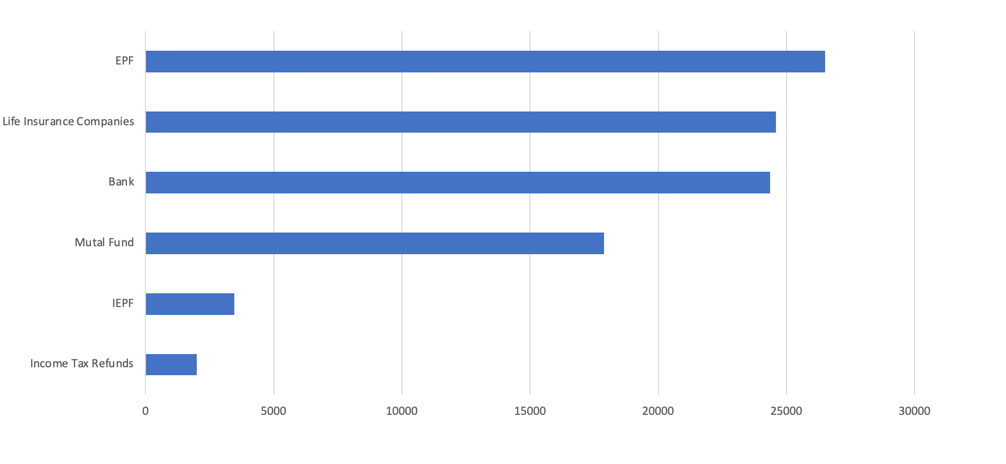

Rs. 98779 Crore lying unclaimed in India

Slide 21


Slide 22

THANK YOU
Contact us:-
Contact No:- +919769432143
Mail id:- connect@ArthaInvest.in

